Slide 1
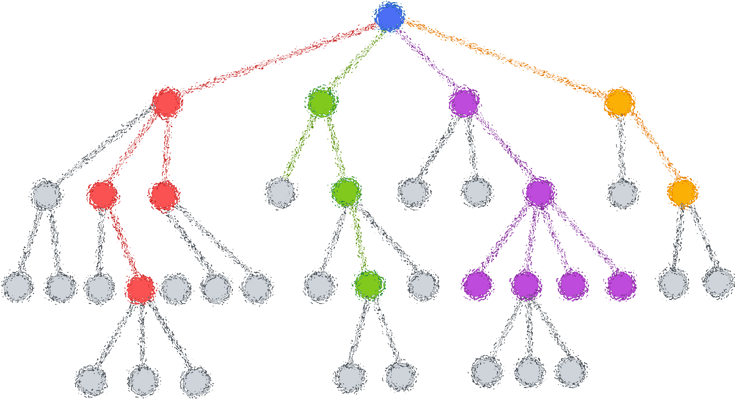

Lecture 10: Decision Tree (Regression)
CSE445 Machine Learning
Dr. Jilan Samiuddin (JSA)
Assistant Professor
North South University

Slide 2
Introduction
Decision Tree Regression models relationships by recursively partitioning data into subsets, creating a tree-like structure
Unlike classification trees that predict categories, regression trees predict continuous numerical values
Each leaf node contains a predicted value

Slide 3
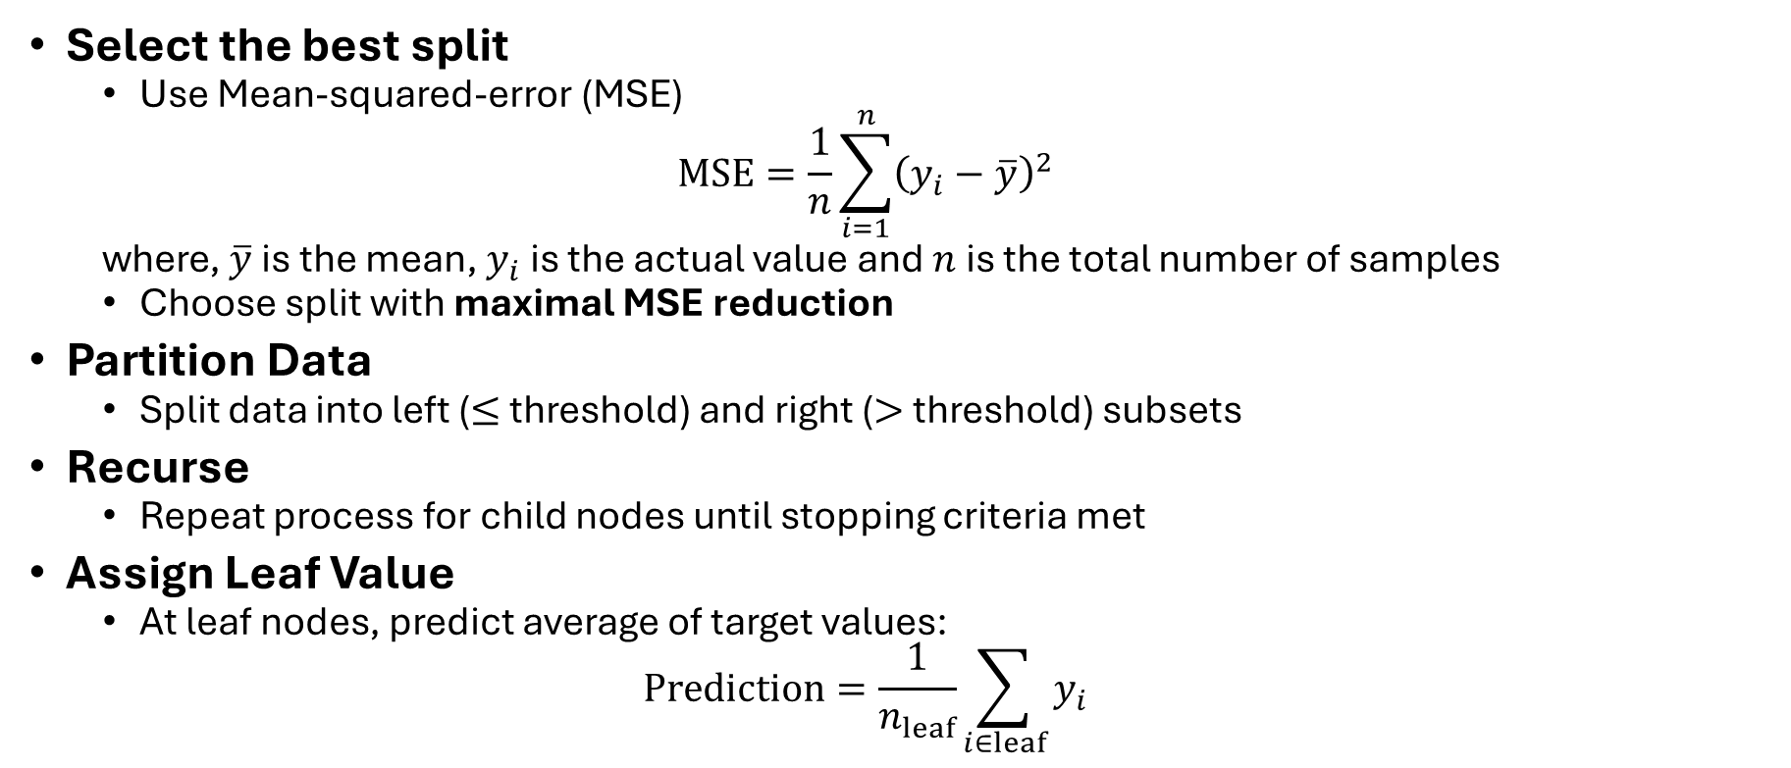
Step-by-Step Algorithm
Select the best split
Use Mean-squared-error (MSE)
$$MSE=\frac{1}{n}\sum_{i=1}^{n}{{\left(y_{i}−\overline{y}\right)}^{2}}$$
where, $\overline{y}$ is the mean, $y_{i}$ is the actual value and $n$ is the total number of samples
Choose split with maximal MSE reduction
Partition Data
Split data into left ($≤$ threshold) and right ($>$ threshold) subsets
Recurse
Repeat process for child nodes until stopping criteria met
Assign Leaf Value
At leaf nodes, predict average of target values:
$$Prediction=\frac{1}{n_{leaf}}\sum_{i∈leaf}{y_{i}}$$

Slide 4
Stopping Criteria
Node is pure
Maximum tree depth reached
Hard stop on how deep the tree can grow
Prevents deep trees that overfit
Minimum MSE Reduction
Stop splitting if the reduction in MSE is less than a threshold
Minimum Samples per Leaf
Do not split if it results in too few samples in a leaf
Minimum Samples per Split
Do not consider a split unless the node has enough samples

Slide 5
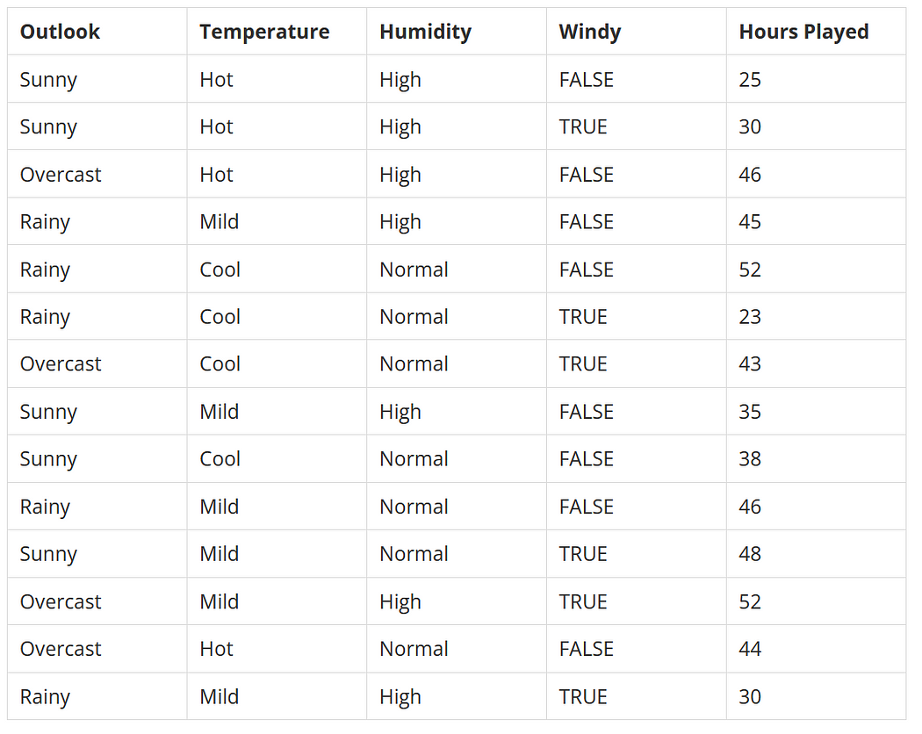
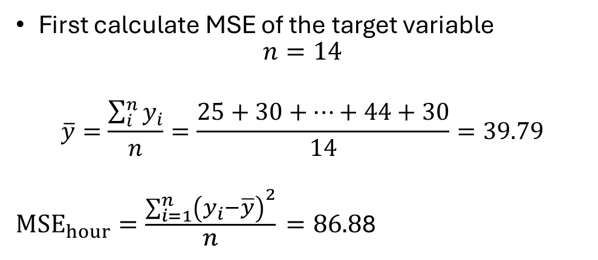
Mathematical Example
A sport hosting company would like to decide to host a cricket match between India and South Africa based on weather data. Weather data that is available has attributes like outlook, temperature, humidity and wind. And has a decision variable how many hours were played.
First calculate MSE of the target variable
$$n=14$$
$$\overline{y}=\frac{\sum_{i}^{n}{y_{i}}}{n}=\frac{25+30+…+44+30}{14}=39.79$$
${MSE}_{hour}=\frac{\sum_{i=1}^{n}{{\left(y_{i}−\overline{y}\right)}^{2}}}{n}=86.8$8

Slide 6
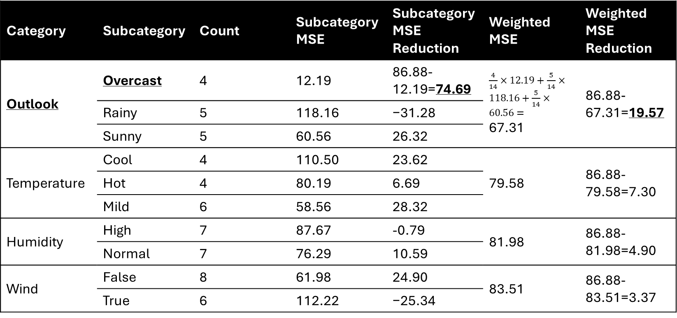
First iteration
Category | Subcategory | Count | Subcategory MSE | Subcategory MSE Reduction | Weighted MSE | Weighted MSE Reduction
Outlook | Overcast | 4 | 12.19 | 86.88-12.19=74.69 | $\frac{4}{14}×12.19+\frac{5}{14}×118.16+\frac{5}{14}×60.56=$ 67.31 | 86.88-67.31=19.57
 | Rainy | 5 | 118.16 | −31.28
 | Sunny | 5 | 60.56 | 26.32
Temperature | Cool | 4 | 110.50 | 23.62 | 79.58 | 86.88-79.58=7.30
 | Hot | 4 | 80.19 | 6.69
 | Mild | 6 | 58.56 | 28.32
Humidity | High | 7 | 87.67 | -0.79 | 81.98 | 86.88-81.98=4.90
 | Normal | 7 | 76.29 | 10.59
Wind | False | 8 | 61.98 | 24.90 | 83.51 | 86.88-83.51=3.37
 | True | 6 | 112.22 | −25.34

Slide 7

Second iteration: Outlook != Overcast
$$n=10$$
$$\overline{y}=\frac{25+30+45+…+48+30}{10}=37.2$$
$${MSE}_{hour}=\frac{\sum_{i=1}^{n}{{\left(y_{i}−\overline{y}\right)}^{2}}}{n}=93.36$$

Slide 8
Second iteration: Outlook != Overcast (contd.)
Category | Subcategory | Count | Subcategory MSE | MSE Reduction | Weighted MSE | Weighted MSE Reduction
Outlook | Rainy | 5 | 118.16 | −24.80 | 89.36 | 4.00
 | Sunny | 5 | 60.56 | 32.80
Temperature | Cool | 3 | 140.22 | −46.86 | 68.00 | 25.36
 | Hot | 2 | 6.25 | 87.11
 | Mild | 5 | 49.36 | 44.00
Humidity | High | 5 | 46.00 | 47.36 | 75.72 | 17.64
 | Normal | 5 | 105.44 | −12.08
Wind | False | 6 | 76.47 | 16.89 | 80.16 | 13.20
 | True | 4 | 85.69 | 7.67

Slide 9

Second iteration: Outlook == Overcast (contd.)
$$n=4$$
$$\overline{y}=\frac{46+43+52+44}{4}=46.25$$
$${MSE}_{hour}=\frac{\sum_{i=1}^{n}{{\left(y_{i}−\overline{y}\right)}^{2}}}{n}=12.19$$

Slide 10
Second iteration: Outlook == Overcast (contd.)
Category | Subcategory | Count | Subcategory MSE | MSE Reduction | Weighted MSE | Weighted MSE Reduction
Outlook | Overcast | 4 | 12.19 | 0.00 | 12.19 | 0.00
Temperature | Cool | 1 | 0.00 | 12.19 | 0.50 | 11.69
 | Hot | 2 | 1.00 | 11.19
 | Mild | 1 | 0.00 | 12.19
Humidity | High | 2 | 9.00 | 3.19 | 4.62 | 7.56
 | Normal | 2 | 0.25 | 11.94
Wind | False | 2 | 1.00 | 11.19 | 10.62 | 1.56
 | True | 2 | 20.25 | −8.06

Slide 11
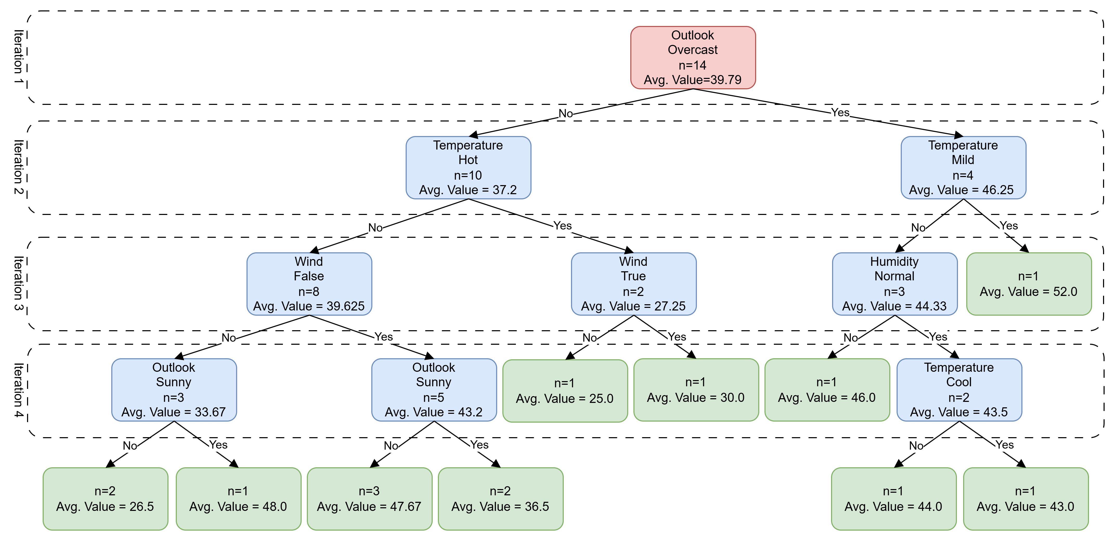
Decision Tree (After 4 iterations)

Slide 12
Predict: Outlook=Rainy, Temperature=Mild, Wind=False, Humidity=Normal

Slide 13
Predict: Outlook=Rainy, Temperature=Hot, Wind=False, Humidity=Normal

